Slide 1

YAML Lecture-1
www.corvit.com

Slide 2
Topics
Course Outline
VS Code
Yaml Introduction
Basic Structure of Yaml
Yaml Formats
Yaml Examples
JSON Structure
XML Structure
Indentation and Separation in Yaml
Comments in Yaml
Data Types in Yaml
www.corvit.com

Slide 3
Course Outline
YAML – 3
VCS – 2
Docker – 4
Kubernetes – 4
Helm – 3
CI / CD – 5
IAC – 5
Monitoring & Logging – 4
Case Study – 1
www.corvit.com

Slide 4
VS Code
Visual Studio Code is a streamlined code editor with support for development operations like debugging, task running, and version control. It aims to provide just the tools a developer needs for a quick code-build-debug cycle and leaves more complex workflows to fuller featured IDEs, such as Visual Studio IDE.
Yaml
Git
Bash
PowerShell
Python
JSON (ARM Template)
HarshiCorp
CLI
www.corvit.com

Slide 5
VS Code Installation
Use the following link to install VS Code on Windows, Linux or Mac OS. “https://code.visualstudio.com/download”
www.corvit.com

Slide 6
YAML
YAML is the abbreviated form of “YAML Ain’t markup language” is a data serialization language which is designed to be human -friendly and works well with other programming languages for everyday tasks.
YAML was specifically created to work well for common use cases such as configuration files, log files and cross language sharing files and data sharing.
Like JSON and XML but not a substitute
Works perfectly with almost all programming languages like Python, Go, JS, Java etc.
The main advantage is Readability and Writability.
File extension is .yaml or .yml
www.corvit.com

Slide 7
History
The YAML 1.0 specification was published in early 2004 by by Clark Evans, Oren Ben-Kiki, and Ingy döt Net after 3 years of collaborative design work through the yaml-core mailing list. The project was initially rooted in Clark and Oren’s work on the SML-DEV mailing list (for simplifying XML) and Ingy’s plain text serialization module for Perl. The language took a lot of inspiration from many other technologies and formats that preceded it.
The first YAML framework was written in Perl in 2001 and Ruby was the first language to ship a YAML framework as part of its core language distribution in 2003.
The YAML 1.1 specification was published in 2005. Around this time, the developers became aware of JSON. By sheer coincidence, JSON was almost a complete subset of YAML (both syntactically and semantically).
www.corvit.com

Slide 8
History
In 2006, Kyrylo Simonov produced PyYAML and LibYAML. A lot of the YAML frameworks in various programming languages are built over LibYAML and many others have looked to PyYAML as a solid reference for their implementations.
The YAML 1.2 specification was published in 2009. Its primary focus was making YAML a strict superset of JSON. It also removed many of the problematic implicit typing recommendations.
www.corvit.com

Slide 9
History
Since the release of the 1.2 specification, YAML adoption has continued to grow, and many large-scale projects use it as their primary interface language. In 2020, the new YAML language design team began meeting regularly to discuss improvements to the YAML language and specification; to better meet the needs and expectations of its users and use cases.
This YAML 1.2.2 specification, published in October 2021, is the first step in YAML’s rejuvenated development journey. YAML is now more popular than it has ever been, but there is a long list of things that need to be addressed for it to reach its full potential. The YAML design team is focused on making YAML as good as possible.
www.corvit.com

Slide 10
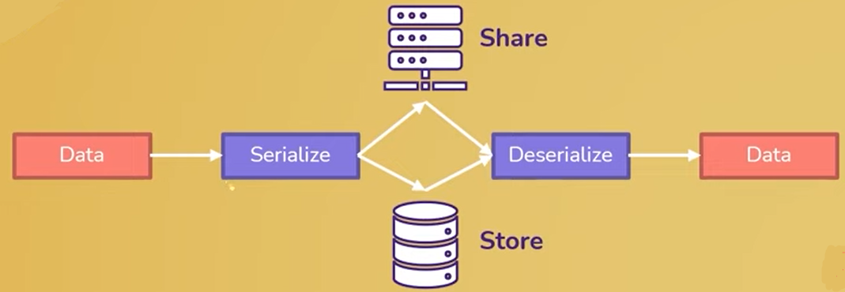
Data Serialization
It is the process of converting data to a format that could be easily stored(and recovered) or sent over network.
For example, you could use Python to serialize the data and sent it over the network to a JavaScript program that will deserialize the data and use it.
www.corvit.com

Slide 11
Yaml Pros & Cons
Pros
Cons
Lightweight
It is very easy and simple to represent the complex mapping
Human friendly readable and writable
Simple to modify with any text editor
Suitable for configuration settings
Support for major programming languages
It is a new format introduced recently, and a learning curve exists.
Not much popular other than XML and JSON
It is very complex to represent configuration in the hierarchy of data
www.corvit.com

Slide 12
Yaml used for configuring tools
CI/CD (Jenkins, Azure DevOps)
Docker
Kubernetes
Helm
Ansible
Prometheus
Grafana
Datadog
www.corvit.com

Slide 13
Basic Structure
Everything in the Yaml is a key-value pair also know as Dictionary/Hash/Object/Map <key> : <value>
These are building blocks of yaml and every item in a yaml document is a member of at least one dictionary.
Yaml doesn’t allow the use of tab character for indentation. Use spaces instead.
Yaml is case sensitive.
The keys are always strings and values can be of any data type that yaml supports like Boolean, numbers, lists, arrays and strings.
www.corvit.com

Slide 14
Basic Structure
The file starts with three hyphens(---) to indicate the start of a new document.
The separation of documents in YAML is denoted by three dashes (---). The end of document is represented with three dots (…).
Whitespace is a part of yaml’s formatting
Newlines indicate the end of a field
Indentation level can be one or more spaces and is used for nesting key-values.
Comments in YAML begins with the (#) character.
Comments must be separated from other tokens by whitespaces.
List members are denoted by a leading hyphen (-).
List members are enclosed in square brackets and separated by commas.
Associative arrays are represented using colon ( : ) in the format of key value pair. They are enclosed in curly braces {}.
www.corvit.com

Slide 15
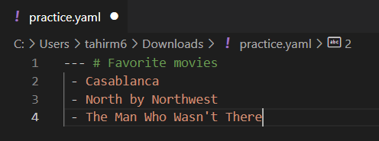
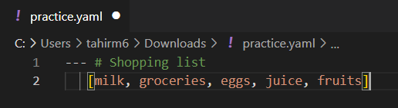
Yaml Formats
Inline Format
Conventional Block Format
This block format uses hyphen+space to begin a new item in a specified list. Observe the example shown below −
Inline format is delimited with comma and space and the items are enclosed in JSON. Observe the example shown below −
www.corvit.com

Slide 16
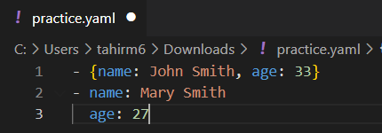
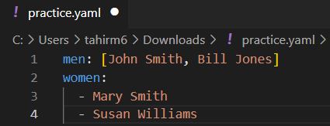
Yaml Formats
Folded Text
Conventional
Folded text converts newlines to spaces and removes the leading whitespace. Observe the example shown below −
The structure which follows all the basic conventions of YAML is shown below −
www.corvit.com

Slide 17
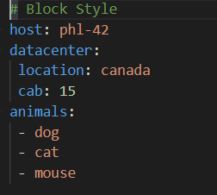
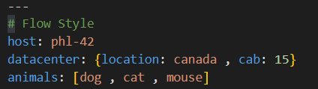
Yaml Styles
Block Style
Flow Style
Block style is less compact and better for humans. Traditional YAML makes it easy for humans to look at the file, scan it down, and see what's going on.
Flow style is an extension of JSON. It is used to allow YAML and JSON to work together. Flow style is less human-readable, but sometimes they are better for the computer that processing our YAML. Flow style is used to fold the long line of content.
www.corvit.com

Slide 18
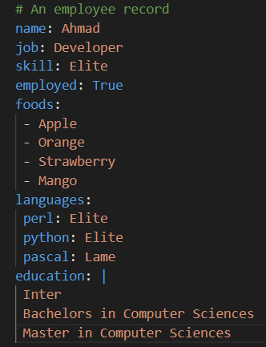
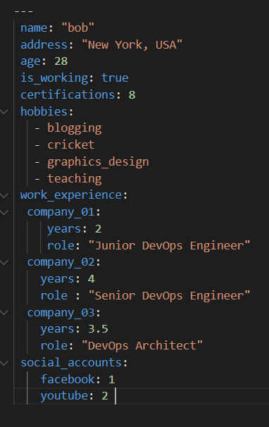
Examples
www.corvit.com

Slide 19
Yaml Validation
Install the yaml extension to VS code let you automatically validate the configurations.
Sublime Editor is another good option for writing yaml files
Instead of using any editor you can use any yaml parser tool to validate yaml file. One of the best is yaml lint. “https://www.yamllint.com/”
www.corvit.com

Slide 20
Yaml Online Parser
To see the output of your yaml configuration in other languages like Python and JSON use the following link for the online yaml parser tool.
“https://yaml-online-parser.appspot.com/”
www.corvit.com

Slide 21
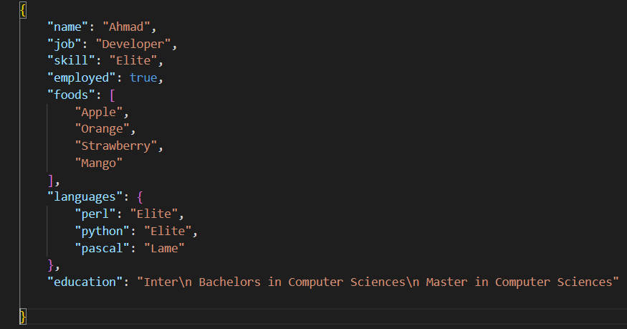
JSON Structure
Yaml uses Newlines and Indentations as opposed to JSON, which uses brackets and braces. We would use JSON for configuring ARM Templates.
www.corvit.com

Slide 22
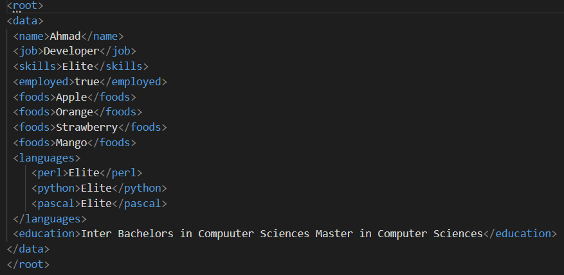
XML Structure
An XML tree starts at a root element and branches from the root to child elements. Used in Java Platform , World Wide Web, intranets and elsewhere.
www.corvit.com

Slide 23


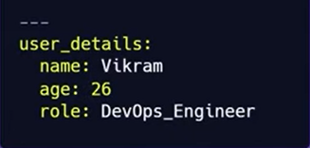
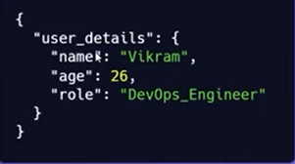
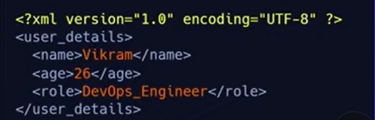
Yaml vs JSON vs XML
Yaml
https://onlineyamltools.com/
to convert yaml to json or xml
www.corvit.com

Slide 24
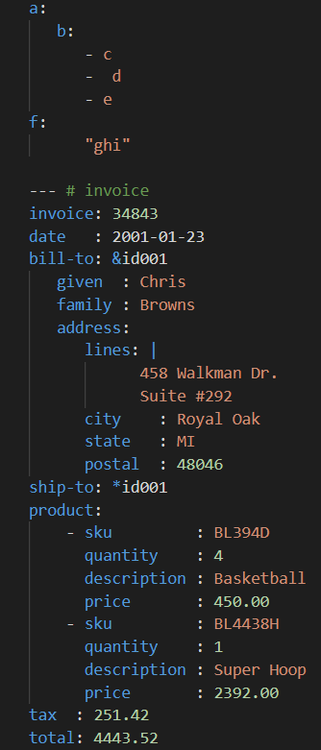
Indentation in YAML
YAML does not include any mandatory spaces. Further, there is no need to be consistent.
Flow blocks must be intended with at least some spaces with surrounding current block level.
Flow content of YAML spans multiple lines. The beginning of flow content begins with { or [.
Block list items include same indentation as the surrounding block level because - is considered as a part of indentation.
www.corvit.com

Slide 25
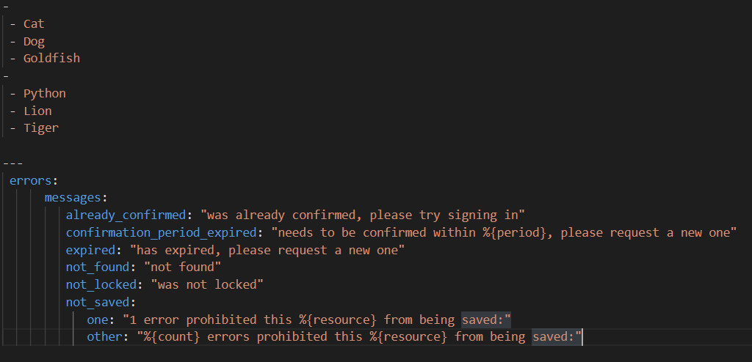
Separation of Strings in Yaml
Strings are separated using double-quoted string. If you escape the newline characters in a given string, it is completely removed and translated into space value.
In first block example we have focused listing of animals listed as an array structure with data type of string. Every new element is listed with a prefix of hyphen as mentioned as prefix.
This example refers to the set of error messages which a user can use just by mentioning the key aspect and to fetch the values accordingly.
www.corvit.com

Slide 26
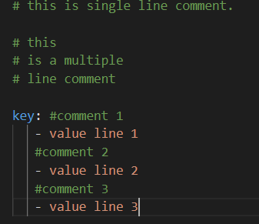
Comments in Yaml
YAML supports single line comments.
YAML does not support multi line comments.
A commented block is skipped during execution.
Comments help to add description for specified code block.
Comments must not appear inside scalars.
YAML does not include any way to escape the hash symbol (#) so within multi-line string so there is no way to divide the comment from the raw string value.
www.corvit.com

Slide 27
Mapping
YAML mappings are also known as associative arrays, hash tables, key: value pairs, or collection. In mapping, the name of two keys can't be the same. There are four types of mapping:
Simple mapping
Sequence mapping
Nested mapping
Mixed mapping
www.corvit.com

Slide 28
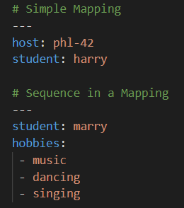
Mapping
Simple Mapping : In simple mapping, we will provide a key in the first part, and then separate with a colon and space. It is necessary to use a space. We will put each member of the list on a new line if we want to add a keyed list(dictionary) on our document
Sequence in a Mapping: We can map the value of the key in sequence
www.corvit.com

Slide 29
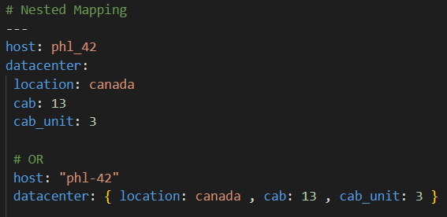
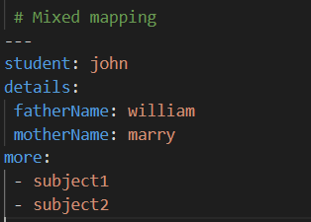
Mapping
Nested Mapping: We can nest our mapping within each other.
Mixed mapping: In mixed mapping, we have an assortment of mapping and sequences as values.
www.corvit.com

Slide 30
Data Types in Yaml
YAML has three types of data types:
Scalar
List
Dictionary
Scalar data type:
Scalar is a simple data type. In YAML, scalar means a simple value for a key. The value of the scalar can be integer, float, Boolean, and string. Scalar data types are classified into two data types:
Numeric Data type
String
www.corvit.com

Slide 31
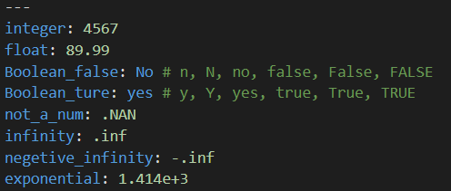
Data Types in Yaml
Numeric Data type:
There are three types of numeric data type:
Integer
Floating point numbers
Booleans
An Integer data type can be decimal, octal, or hexadecimal.
www.corvit.com

Slide 32
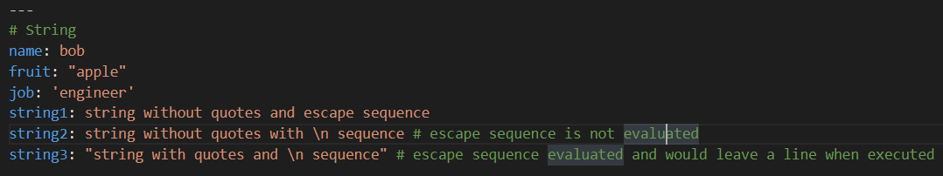
Data Types in Yaml
String Data type:
Strings in Yaml can be represented with or without quotes.
But, escape sequences are evaluated only when strings are enclosed in double quotes.
www.corvit.com

Slide 33
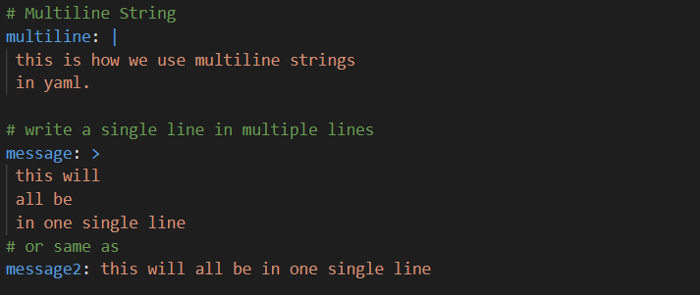
Data Types in Yaml
Multiline String:
Yaml supports multiline strings as value to a key using the characters:
Block (|) : Interprets newlines
Fold (>) : Does not interpret newlines
www.corvit.com

Slide 34
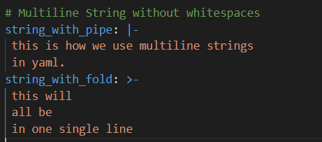
Data Types in Yaml
Multiline String:
Multiline Strings can end with whitespaces. Use the strip operator (-), the whitespaces can be removed.
Block (|-)
Fold (>-)
www.corvit.com

Slide 35
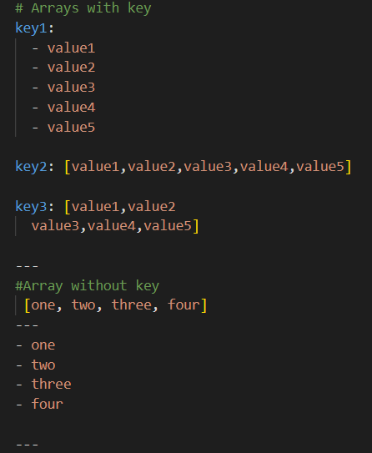
Array List (Sequences)
An array is a group of similar values with a single name. In YAML, Array represents a single key mapped to multiple values. Each value starts with a hyphen - symbol followed by space.
In a single line, write the same thing above using ‘square brackets syntax.’
Without a key, arrays can be represented in single line using square brackets or can also be declared in a single line
www.corvit.com

Slide 36
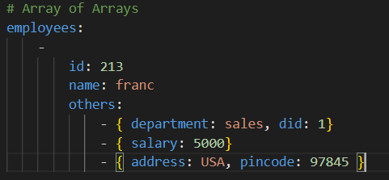
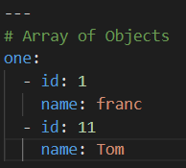
Array List
Arrays of Arrays are also called multi-dimensional arrays or nested arrays.
Objects contain multiple key and value pairs. An Array of Objects contains an object list.
www.corvit.com

Slide 37
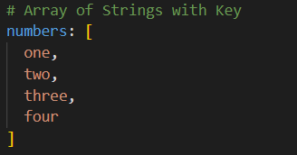
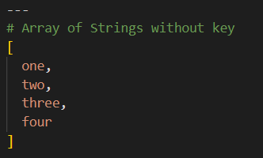
Array List
Strings contain a group of characters. It is a scalar type in yaml.
Keys in the string array are optional in YAML. Here is an example of an Array of Strings with keys.
Here is an example array of strings without key
www.corvit.com

Slide 38
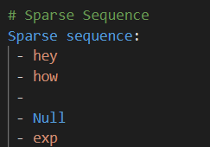
Array List
Sparse Sequence:
Some of the keys of sequence would be empty. The sequence with such keys is know as Sparse Sequence.
www.corvit.com

Slide 39
Dictionary
If we want to write a complex YAML file which holds the complex data structure, we will use dictionaries. It is a collection of key: value pairs and each of the key: value pairs can be nested with a lot of options.
The dictionary contains keys and values.
In Yaml Dictionary can be represented in two syntaxes
- Flow Style
- Block Style
www.corvit.com

Slide 40
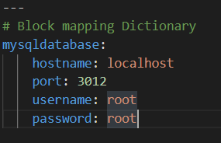
Dictionary
Flow Style
Block Style
In this, key and value pairs are separated by a comma and entire pairs are enclosed in {} characters.
In this key and value pairs are represented using colon “:”
www.corvit.com

Slide 41
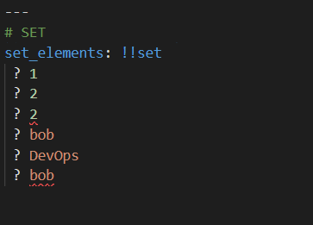
Data Types in Yaml
SET:
Set in Yaml contains unique values similar to Pythons’ set data type
Set items are preceded by the question mark (?) like list items are preceded by hyphens (-)
We need to mention that the data type is set using !!set after the set name.
Duplicate values are removed automatically.
www.corvit.com

Slide 42
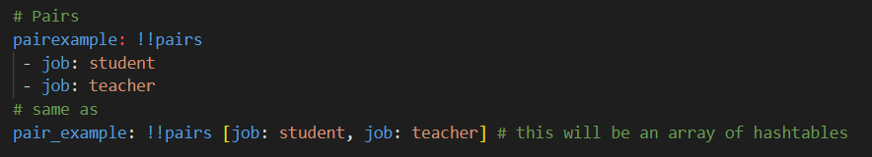
Data Types in Yaml
Pairs:
Keys which may have duplicate values are created as pairs.
Have to specify like (!!pairs)
Set would have unique values
www.corvit.com

